Slide 1
The Sine Qua Nons of Heaven
Those Things Without Which
Heaven Would Not Be Heaven

Slide 2
The Sine Qua Nons of Heaven
Those Things Without Which
Heaven Would Not Be Heaven

Slide 3
The Sine Qua Nons Of Heaven
Imagine you could eat as much as you wanted of anything you liked, without ill effects...

Slide 4
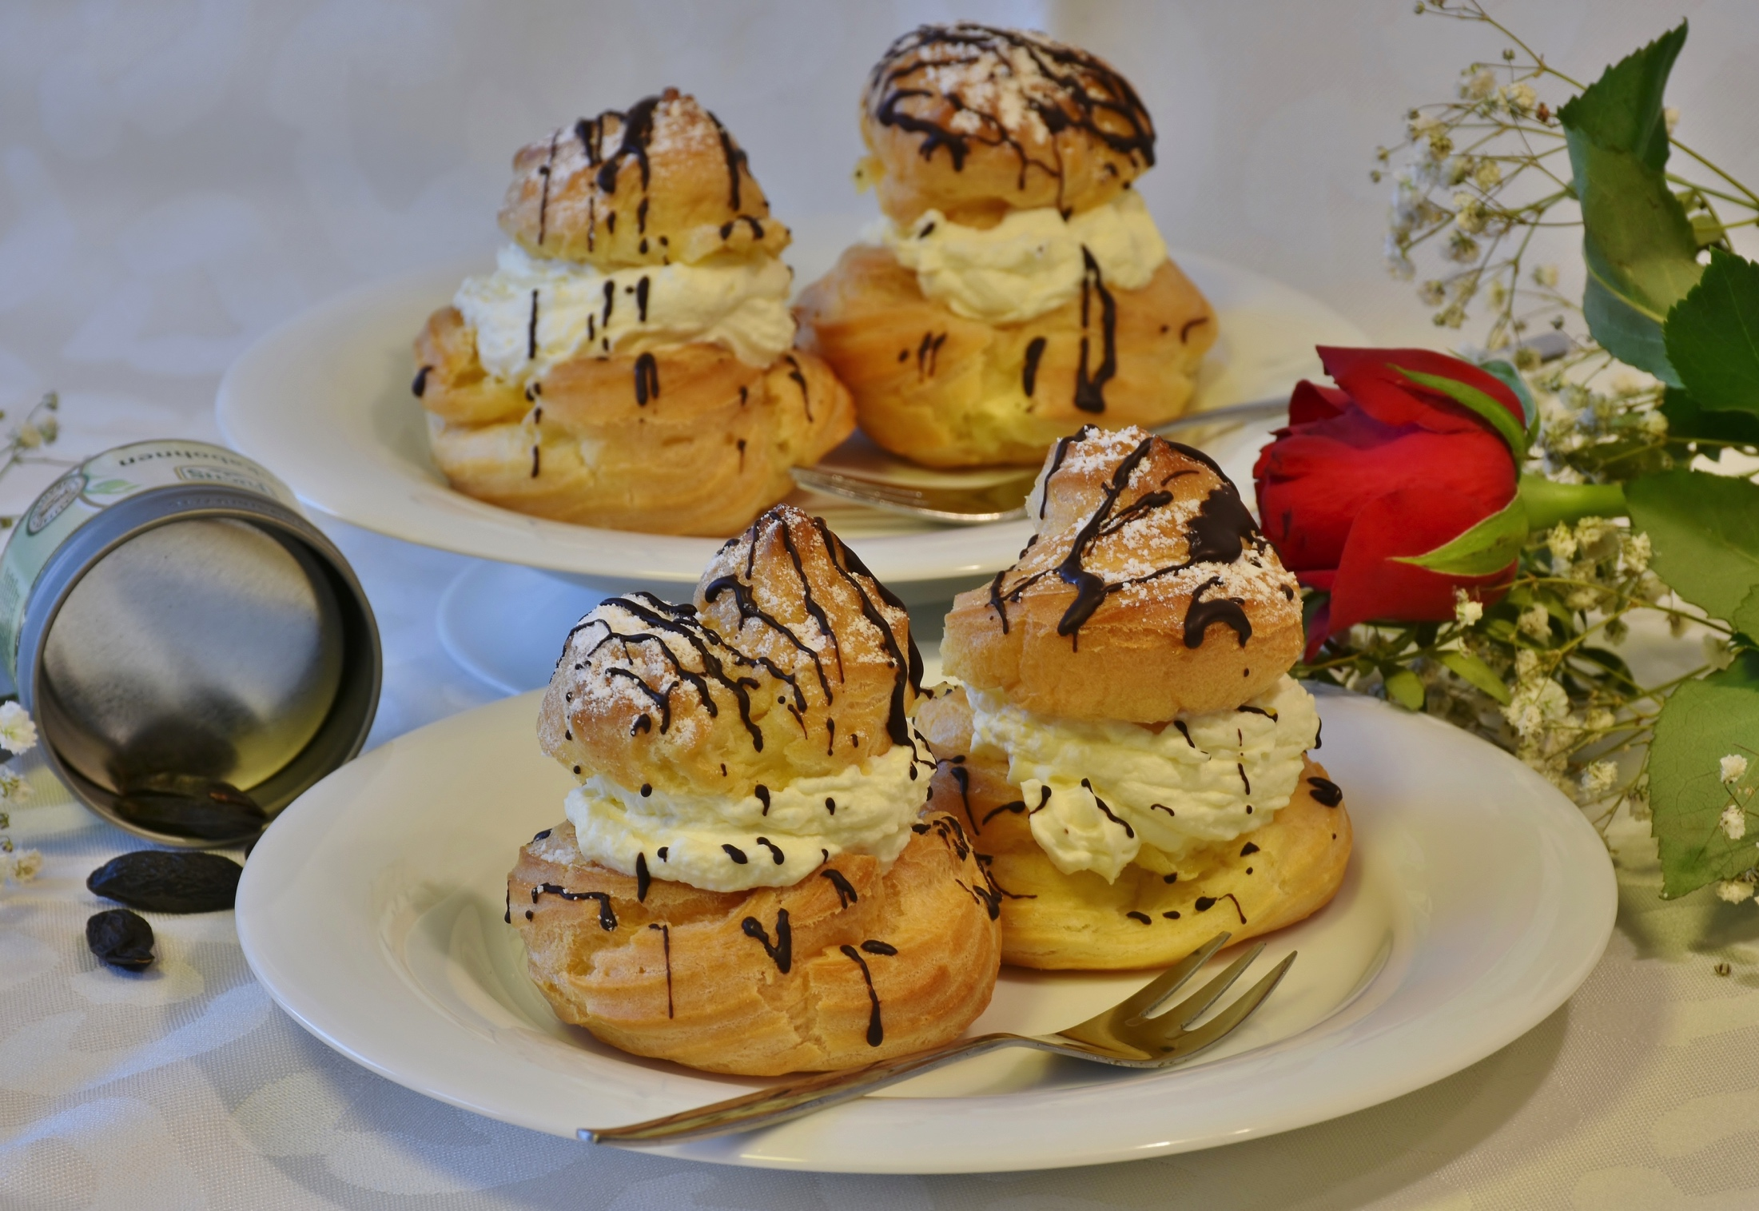
The Sine Qua Nons Of Heaven

Slide 5
The Sine Qua Nons Of Heaven
Imagine you could eat as much as you wanted of anything you liked, without ill effects...
so long as you ate alone.

Slide 6
The Sine Qua Nons Of Heaven
Imagine playing any sport you wanted, whenever you wanted, and with a champion’s skill…

Slide 7
The Sine Qua Nons Of Heaven
Imagine playing any sport you wanted, whenever you wanted, and with a champion’s skill…
always against robots, with no spectators, no one to talk to afterwards.

Slide 8
The Sine Qua Nons Of Heaven
Imagine exploring breathtakingly beautiful worlds and discovering amazing creatures…

Slide 9
The Sine Qua Nons Of Heaven
Imagine exploring breathtakingly beautiful worlds and discovering amazing creatures…
but never being able to share your experiences.

Slide 10
The Sine Qua Nons Of Heaven
Sine Qua Non 1:
PERSONAL RELATIONSHIP

Slide 11
The Sine Qua Nons Of Heaven
Sine Qua Non 1:
Personal Relationship requires:
Continuity of unique identity (Revelation 2.17)

Slide 12
The Sine Qua Nons Of Heaven
Sine Qua Non 1:
Personal Relationship requires:
Continuity of unique identity (Revelation 2.17)
Recognizability (Luke 16.9)

Slide 13
The Sine Qua Nons Of Heaven
What if Heaven had every conceivable pleasure except for love?

Slide 14
The Sine Qua Nons Of Heaven
What if Heaven had every conceivable pleasure except for love?
What if someone “loved” you, but had no interest in your thoughts and dreams?

Slide 15
The Sine Qua Nons Of Heaven
Sine Qua Non 2:
INTIMACY

Slide 16
The Sine Qua Nons Of Heaven
Sine Qua Non 2:
INTIMACY
To be simultaneously fully known
and wholly loved.
(cf. 1 Corinthians 13.12b)

Slide 17
The Sine Qua Nons Of Heaven
Sine Qua Non 2:
Wait! We can’t even know ourselves intimately, apart from relationship with our Creator and Redeemer.

Slide 18
The Sine Qua Nons Of Heaven
Sine Qua Non 2:
No one can really know themselves if they do not know their origin, purpose and destiny.

Slide 19
The Sine Qua Nons Of Heaven
Sine Qua Non 2:
Ultimate intimacy is only possible through the One Who knows our heart, gave us our gifts, and planned our destiny (cf. Psalm 36.9).

Slide 20
The Sine Qua Nons Of Heaven
Sine Qua Non 3:
JESUS
Our infinite, omniscient Creator, Redeemer and heavenly Bridegroom.

Slide 21
The Sine Qua Nons Of Heaven
JESUS
Preceded Heaven.

Slide 22
The Sine Qua Nons Of Heaven
JESUS
Preceded Heaven.
Created Heaven and Earth (John 1.3).

Slide 23
The Sine Qua Nons Of Heaven
JESUS
Preceded Heaven.
Created Heaven and Earth (John 1.3).
Tied His eternal destiny to ours (John 1.14).

Slide 24
The Sine Qua Nons Of Heaven
JESUS
Guarantees our eternal joy (Psalm 16.11).

Slide 25
The Sine Qua Nons Of Heaven
JESUS
Guarantees our eternal joy (Psalm 16.11).
Endured the cross for the supreme joy of intimacy with us (Hebrews 12.2).

Slide 26
The Sine Qua Nons Of Heaven
JESUS
IS THE ULTIMATE
SINE QUA NON
OF HEAVEN.

Slide 27
The Sine Qua Nons Of Heaven
— Interlude —
ARRIVING IN HEAVEN

Slide 28
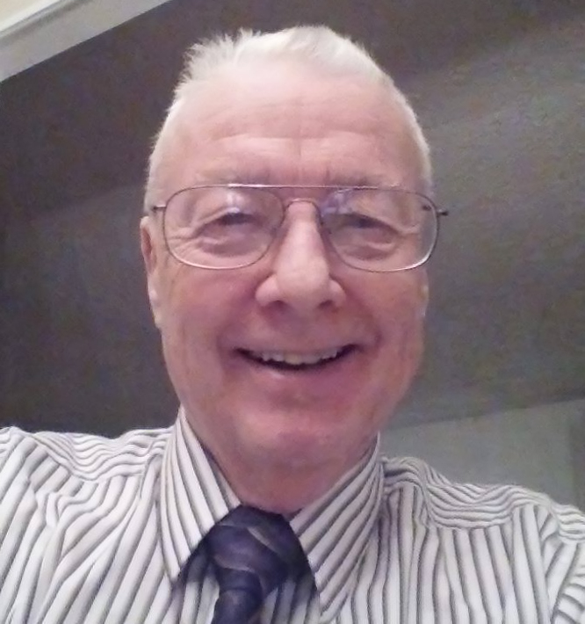
The Sine Qua Nons Of Heaven
Ed Long
1935-2017

Slide 29
The Sine Qua Nons Of Heaven
Let’s tune our hearts to Psalm 73.25:
“Whom have I in heaven but you?
And earth has nothing I desire besides you.”

Slide 30
The Sine Qua Nons Of Heaven
Let’s tune our hearts to Psalm 73.25:
“Whom have I in heaven but you?
And earth has nothing I desire besides you.”
… and get excited about our coming wedding.

Slide 31
The Sine Qua Nons of Heaven
Those Things Without Which
Heaven Would Not Be Heaven

